Slide 1

Cicle mitjà 3
Escola aiguamarina

Slide 2

DAVID BOWIE
https://www.youtube.com/watch?v=VbD_kBJc_gI&list=FLtBtYpxNaE7_GKRDLNQQHYA&index=220

Slide 3

Bob Marley https://www.youtube.com/watch?v=69RdQFDuYPI

Slide 4

https://www.youtube.com/watch?v=v2AC41dglnM

Slide 5
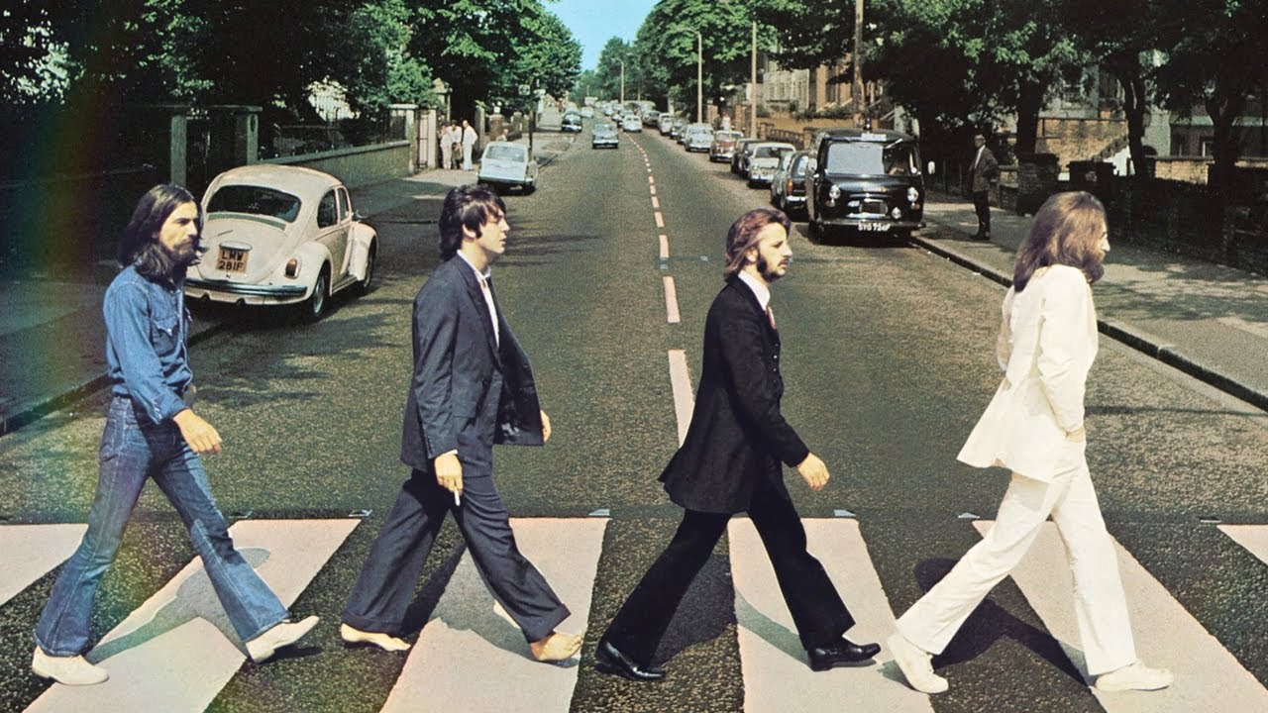
THE BEATLES
https://www.youtube.com/watch?v=m2uTFF_3MaA

Slide 6
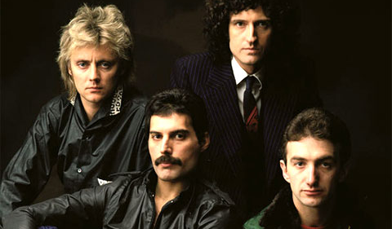
QUEEN
https://www.youtube.com/watch?v=vsl3gBVO2k4

Slide 7
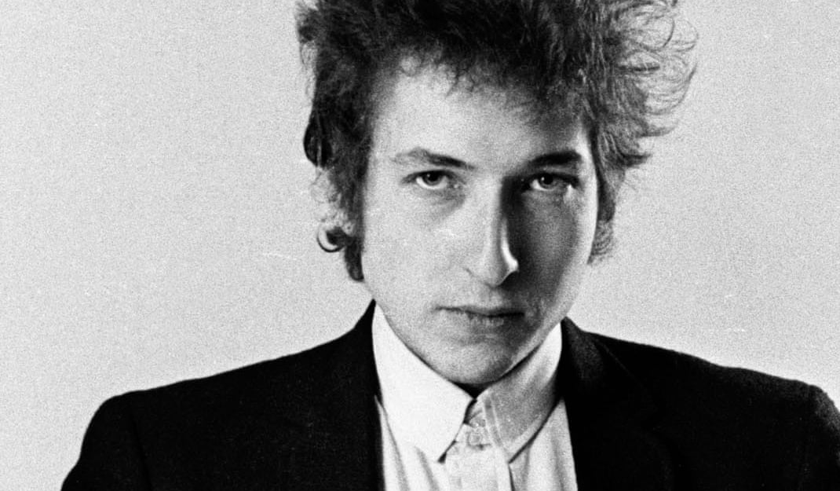
BOB DYLAN
https://www.youtube.com/watch?v=pm6xCwNKtnQ

Slide 8
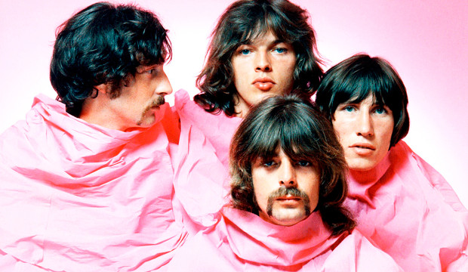
PINK FLOYD
https://www.youtube.com/watch?v=JwYX52BP2Sk

Slide 9
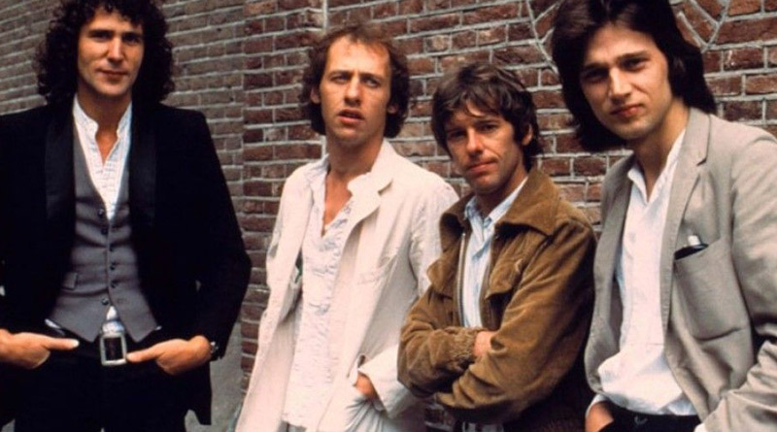
DIRE STRAITS
https://www.youtube.com/watch?v=kd9TlGDZGkI

Slide 10


