Slide 1
ANGLÈS I GES 1
3R TRIMESTRE
Teacher: Íñigo Bordonaba

Slide 2
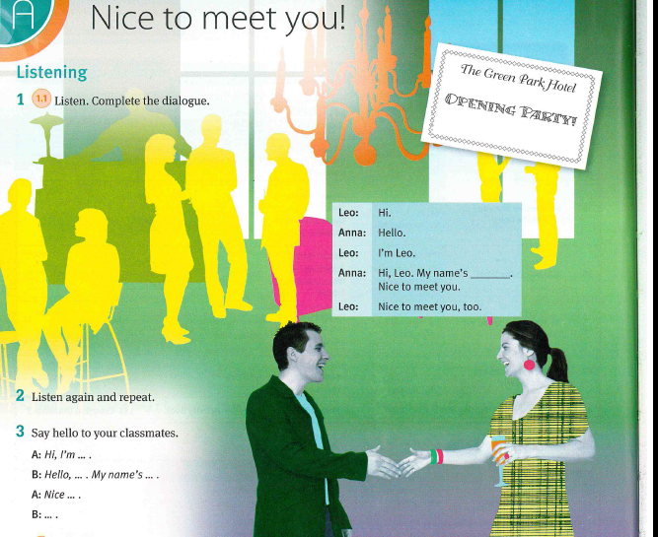

Slide 3
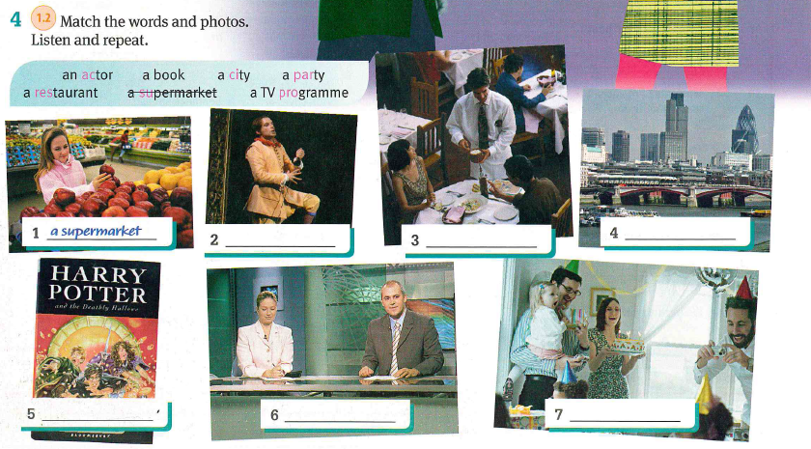

Slide 4


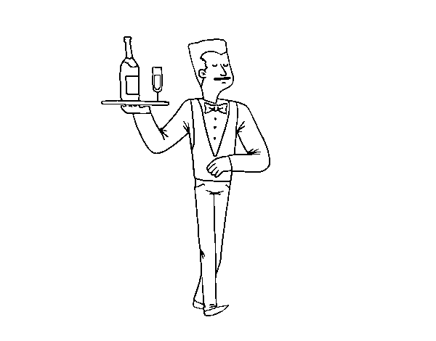

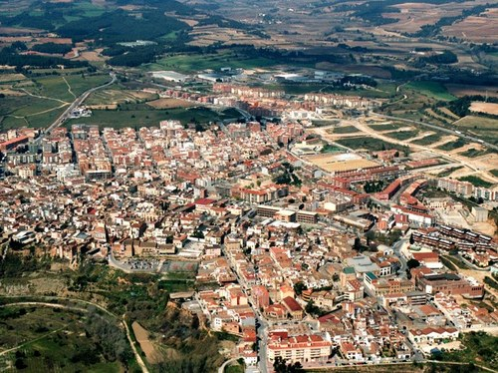

What’s your favourite film?
book?
city?
restaurant?
TV programme?
type of music?
Who is your favourite actor or actress?

Slide 5
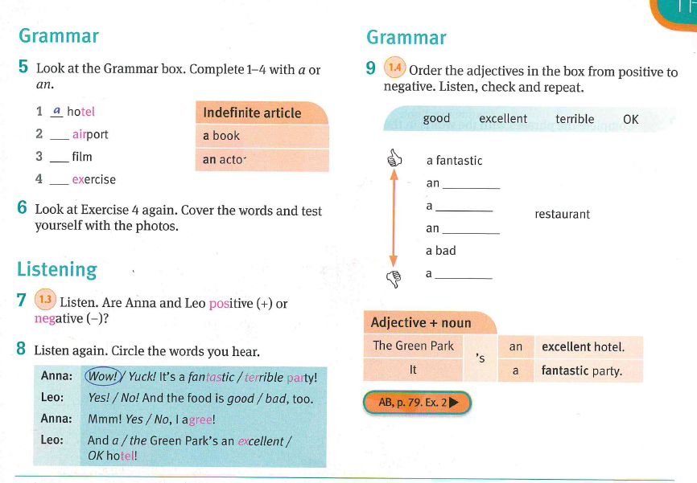

Slide 7
