Slide 1

SIMPLE PAST TENSE

Slide 2
Simple past tense
We use past tense to talk about actions
that happened at a specific time in the past
yesterday
two days ago
in May 2004
last week
five hours ago
in 2000
last month
in the 20th century
last Tuesday

Slide 3
be PAST SIMPLE
We use «be» past simple to describe events or situations.
The verb «be» in the past simple has two forms:
was
were
he
she
you
it
I
we
they

Slide 4


Affirmative and negative forms
was
was not
were
were not
He was
He wasn’t
You were
You weren’t
She was
She wasn’t
We were
We weren’t
It was
It wasn’t
They were
They weren’t
I was
I wasn’t

Slide 5
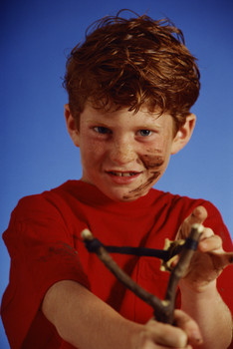

in 1990
in 2013
Mark was very naughty.
Now he is a good businessman.

Slide 6
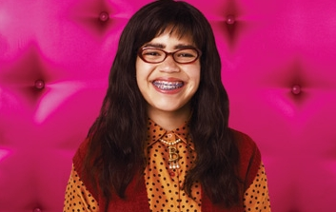
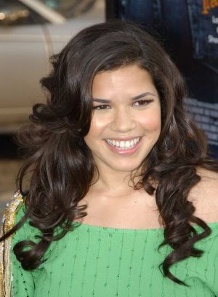
in 2000
in 2016
Betty wasn’t beatiful.
Now she is very beatiful.

Slide 7
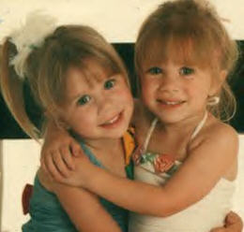
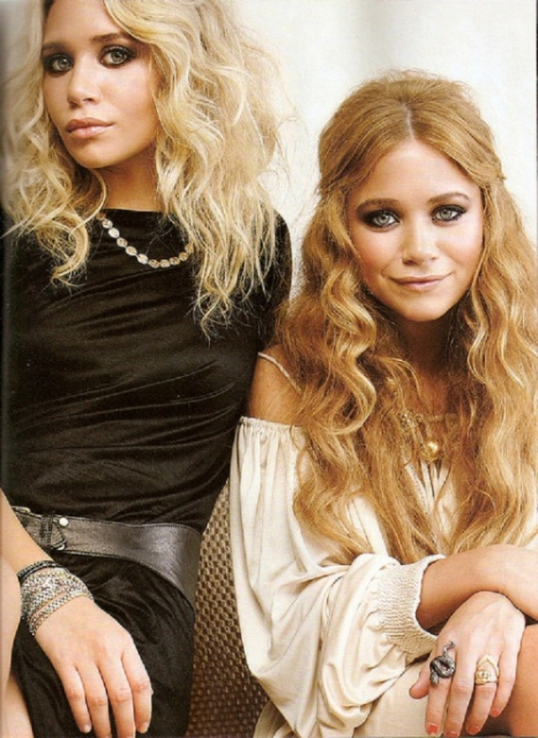
in 1988
in 2016
Olsen twins were babies.
Now they are adults.

Slide 8

Was + subject.. ?
Were + subject.. ?
Was he...?
Was it...?
Were you ...?
Were they ..?
Was she...?
Was I...?
Were we ...?
Wasn’t + subject.. ?
Weren’t + subject.. ?
Wasn’t he...?
Wasn’t it...?
Weren’t you ...?
Weren’t they ...?
Wasn’t she...?
Wasn’t I..?
Weren’t we ...?
Question Form

Slide 9
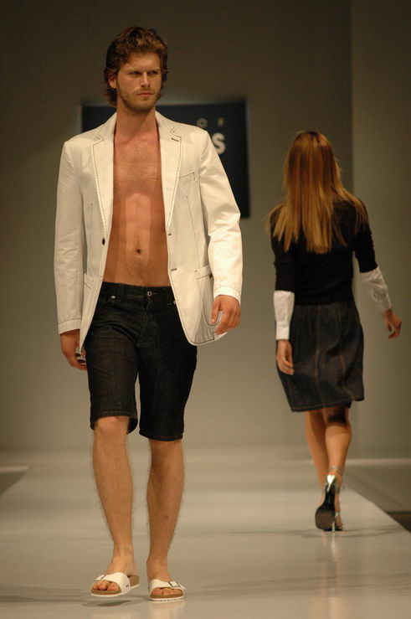
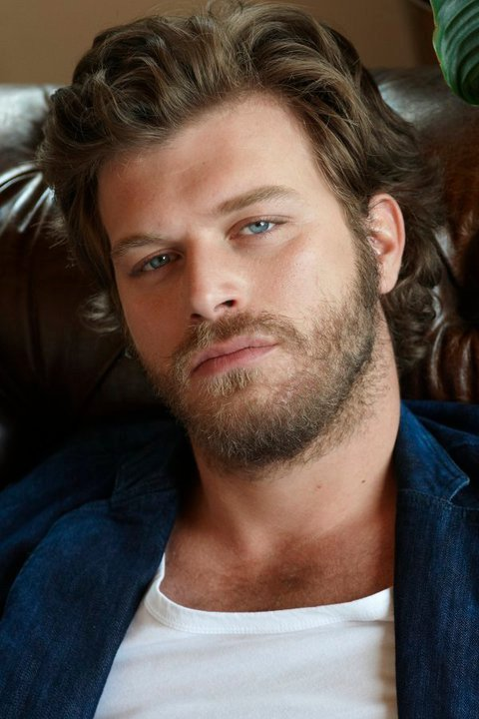
Was Kıvanç Tatlıtuğ a model in 2002 ?
Yes, he was.
in 2002
Now he is an actor.
in 2016

Slide 10
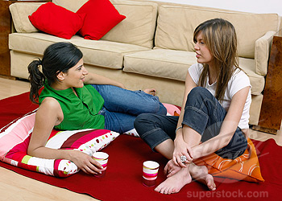
Were you in the party yesterday?
Yes, I was.

Slide 11
Verbs
REGULAR
IRREGULAR
base form verb + ed
no general rule for irregular verbs
play + ed
go - went
work + ed
come - came
start + ed
give - gave

Slide 12
REGULAR VERBS – SPELLING RULES
Double the final consonant of one syllable verbs end in vowel+consonant
stop
+ ed
stopped
one vowel
one consonant
omit
+ ed
omitted
one vowel
one consonant
vowels: a,e,o,u,i
consonants: b,c,d,g,h,j,k,l,m...
REGULAR VERBS – SPELLING RULES

Slide 13
REGULAR VERBS – SPELLING RULES
If the verb ends a consonant + y, the-y changes into an -i
try
+ ed
tried
consonant before -y
-y changes into -i
study
+ ed
studied
consonant before -y
-y changes into -i
REGULAR VERBS – SPELLING RULES

Slide 14

Yesterday, I worked at the office all day.
I was very tired.

Slide 15
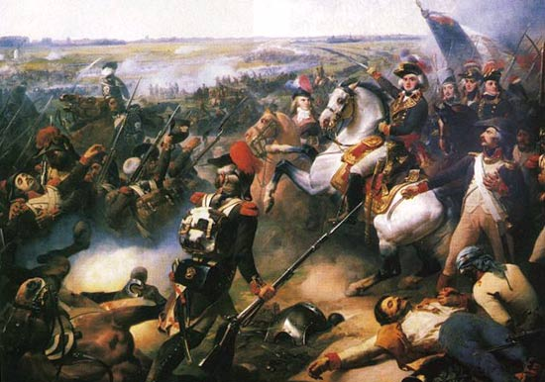
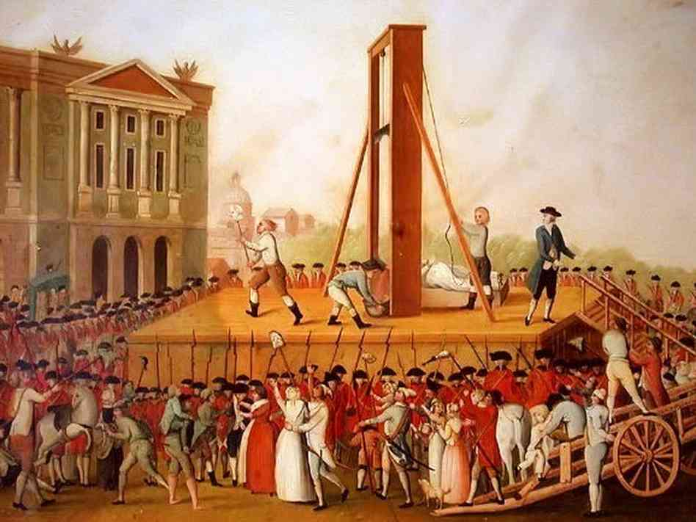
French Revolution started on 14th July 1789.

Slide 16

I bought this phone in Hong Kong last summer.

Slide 17
NEGATIVE FORM OF THE VERBS
did not + base form of the verb
I went to school yesterday.
I didn’t go to school yesterday.
You called me 2 minutes ago.
You didn’t call me 2 minutes ago.
He slept well yesterday.
He didn’t sleep well yesterday.
(SAME FOR ALL SUBJECTS)

Slide 18

QUESTION FORM OF THE VERBS
Did +subject + base form of verb
Did you call me 2 minutes ago?
Did he sleep well yesterday?
Where did you go last week?

Slide 19
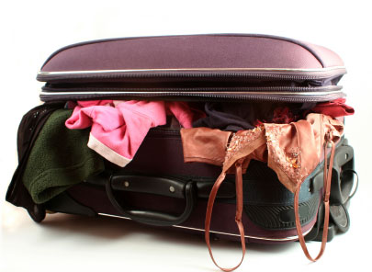
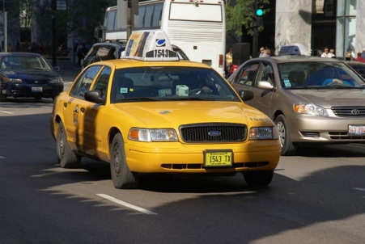


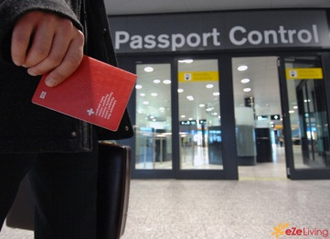
BAD DAY FOR JANE
Yesterday, Jane packed her clothes.
She took a taxi to the airport.
She had a coffee at the airport.
She went to the passport control.
But she didn’t take her passport.
She forgot it at home !

