Slide 1
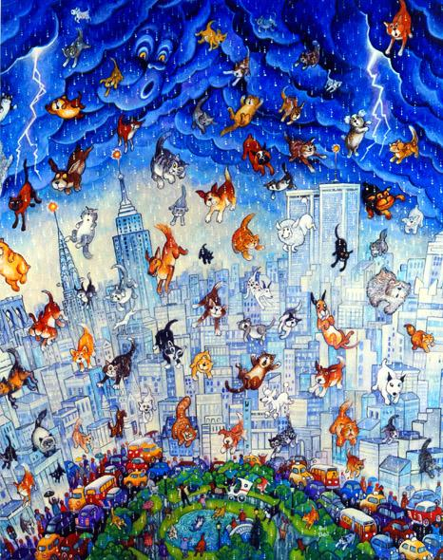
That’s strange!

Slide 2
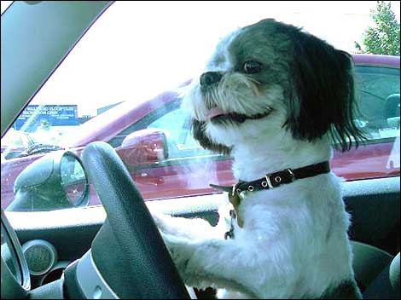
The dog is driving a car.
That’s strange! My dog never drives a car.

Slide 3
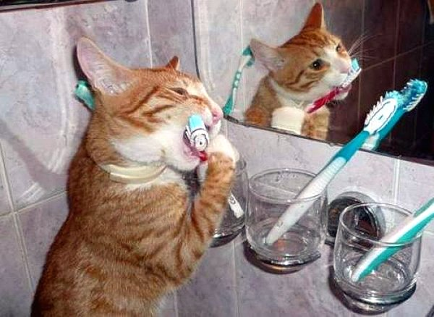
The cat is brushing her teeth!
That’s strange! My cat never brushes her teeth.

Slide 4
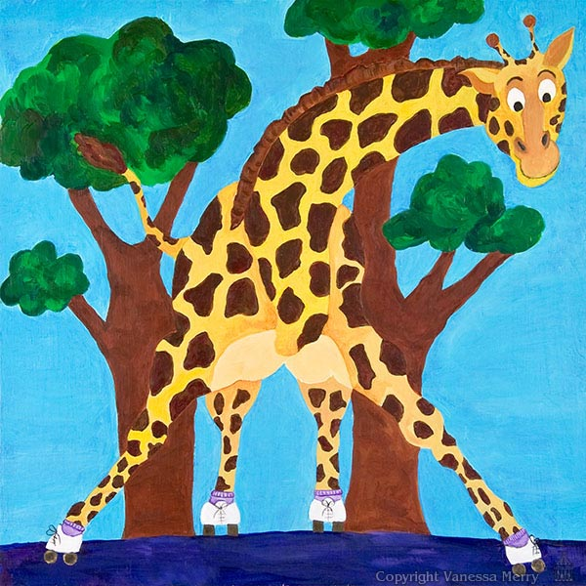
The giraffe is skating!
That’s strange! Giraffes never go skating.

Slide 5
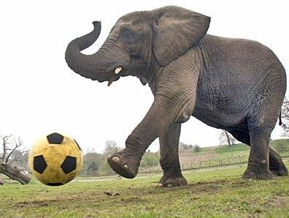
The elephant is playing football!
That’s strange! Elephants never play football.

Slide 6
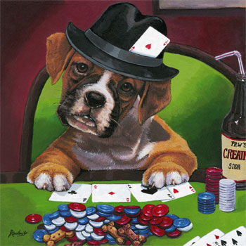
The dog is playing poker!
That’s strange! My dog never plays poker.

Slide 7
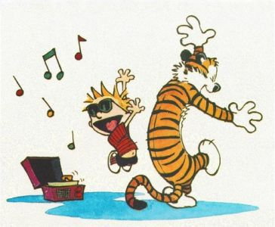
The tiger is dancing to music!
That’s strange! Tigers never dance to music.

Slide 8
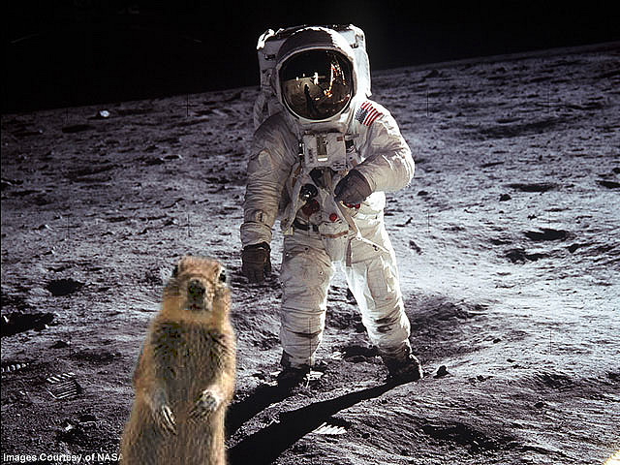
The squirrel is exploring the moon!
That’s strange! Squirrels never explore the moon.

