Slide 1
To BE or Not To BE?
Conjugation, Contractions, and Negations with the Verb BE

Slide 2
to BE
I _________
You _________
He/She/It _________
We __________
You __________
They _________

Slide 3
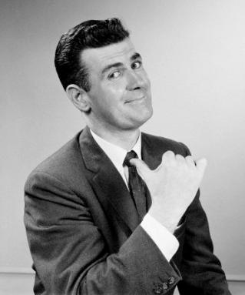
_____________________________

Slide 4

_____________________________

Slide 5
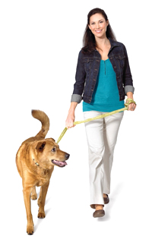
_____________________________

Slide 6

_____________________________

Slide 7

_____________________________

Slide 8
Let’s Review!
I ___________
You ___________
He/she/it ___________
We ___________
You ___________
They ___________
Is there an easier way to say it?

Slide 9
Yes!
Contractions are a shorter way to use BE
I am → __________
You are → ___________
He/She/It is → _____________
We are → ____________
You are → ________________
They are → ________________

Slide 10
Let’s Practice
___________ (I/BE) sixteen years old.
___________ (we/BE) taller than the plant.
___________ (it/BE) twenty past one.
__________ (they/BE) excellent golfers.
___________ (you/BE) quiet students.

Slide 11
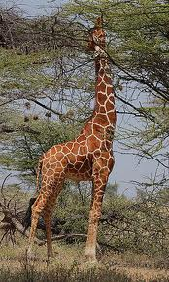
I Am Not!
We can use the verb BE to describe ourselves. For example,
“I am a tall girl.”
We can also use the verb
BE to tell what something
is NOT like.
For example,
“The giraffe is not short.”

Slide 12
How to Form It
We make the negative form of BE by…
Subject + BE + not
For example: “Jose and Leinar are not girls.”

Slide 13
Let’s Practice!
Are you sixty years old?
No, ___________________________________.
Is it six o’clock?
No, ___________________________________.
Is Olga tall?
No, ___________________________________.

